Slide 1
Module7_Mass Storage Systems
Reference: “OPERATING SYSTEM CONCEPTS”, ABRAHAM SILBERSCHATZ, PETER BAER GALVIN, GREG GAGNE , Wiley publications.

Slide 2
Overview of Mass Storage Structure
Magnetic disks provide bulk of secondary storage of modern computers
Drives rotate at 60 to 250 times per second
Transfer rate is rate at which data flow between drive and computer
Positioning time (random-access time) is the time to move disk arm to desired cylinder (seek time) and time for desired sector to rotate under the disk head (rotational latency)
Head crash results from disk head making contact with the disk surface
Disks can be removable
Drive attached to computer via I/O bus

Slide 3
Moving-head Disk Mechanism

Slide 4
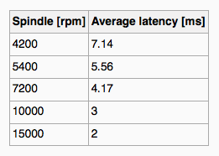
Hard Disks
Platters range from .85” to 14” (historically)
Commonly 3.5”, 2.5”, and 1.8”
Range from 30GB to 3TB per drive
Performance
Transfer Rate – theoretical – 6 Gb/sec
Effective Transfer Rate – real – 1Gb/sec
Seek time from 3ms to 12ms – 9ms common for desktop drives
Average seek time measured or calculated based on 1/3 of tracks
Latency based on spindle speed
1 / (RPM / 60) = 60 / RPM
Average latency = ½ latency
(From Wikipedia)

Slide 5
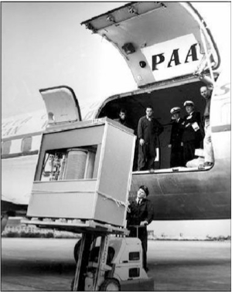
The First Commercial Disk Drive
1956
IBM RAMDAC computer included the IBM Model 350 disk storage system
5M (7 bit) characters
50 x 24” platters
Access time = < 1 second

Slide 6
Disk Structure
Disk drives are addressed as large 1-dimensional arrays of logical blocks, where the logical block is the smallest unit of transfer
Low-level formatting creates logical blocks on physical media
The 1-dimensional array of logical blocks is mapped into the sectors of the disk sequentially
Sector 0 is the first sector of the first track on the outermost cylinder
Mapping proceeds in order through that track, then the rest of the tracks in that cylinder, and then through the rest of the cylinders from outermost to innermost
Logical to physical address should be easy
Except for bad sectors

Slide 7
Disk Scheduling
The operating system is responsible for using hardware efficiently — for the disk drives, this means having a fast access time and disk bandwidth
Minimize seek time
Seek time ≈ seek distance
Disk bandwidth is the total number of bytes transferred, divided by the total time between the first request for service and the completion of the last transfer

Slide 8
Disk Scheduling (Cont.)
There are many sources of disk I/O request
OS
System processes
Users processes
I/O request includes input or output mode, disk address, memory address, number of sectors to transfer
OS maintains queue of requests, per disk or device
Idle disk can immediately work on I/O request, busy disk must queue the requests
Optimization algorithms only make sense when a queue exists

Slide 9
Disk Scheduling (Cont.)
Drive controllers have small buffers and can manage a queue of I/O requests (of varying “depth”)
Several algorithms exist to schedule the servicing of disk I/O requests
We illustrate scheduling algorithms with a request queue (0-199)
98, 183, 37, 122, 14, 124, 65, 67
Head pointer 53

Slide 10
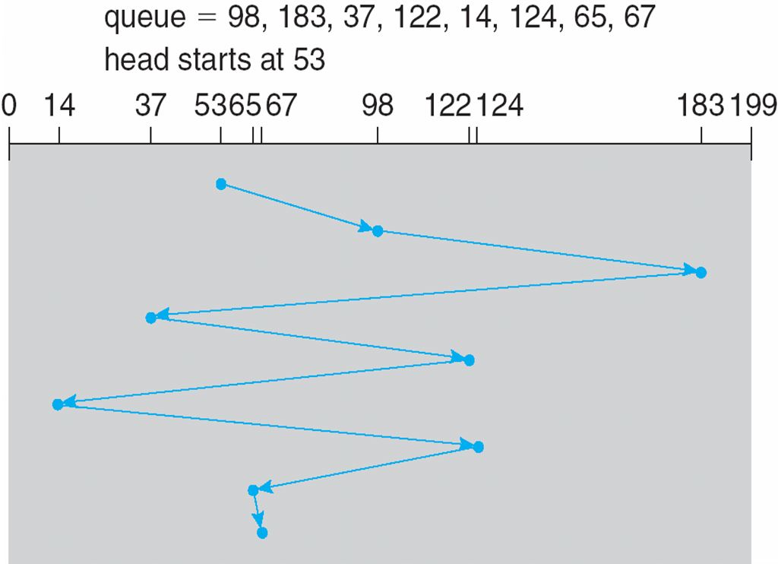
FCFS
Illustration shows total head movement of 640 cylinders

Slide 11
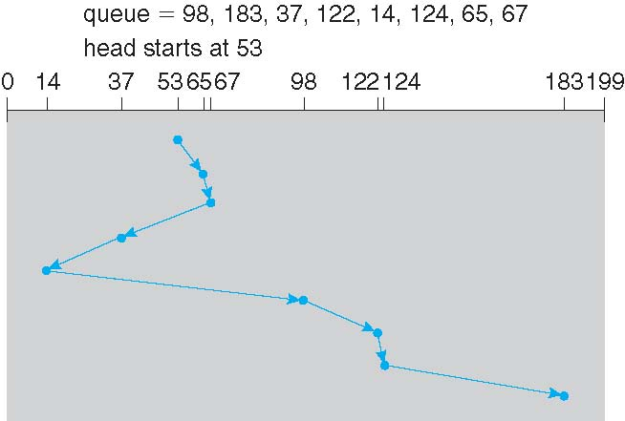
SSTF
Shortest Seek Time First selects the request with the minimum seek time from the current head position
SSTF scheduling is a form of SJF scheduling; may cause starvation of some requests
Illustration shows total head movement of 236 cylinders

Slide 12
SCAN
The disk arm starts at one end of the disk, and moves toward the other end, servicing requests until it gets to the other end of the disk, where the head movement is reversed and servicing continues.
SCAN algorithm is sometimes called the elevator algorithm

Slide 13
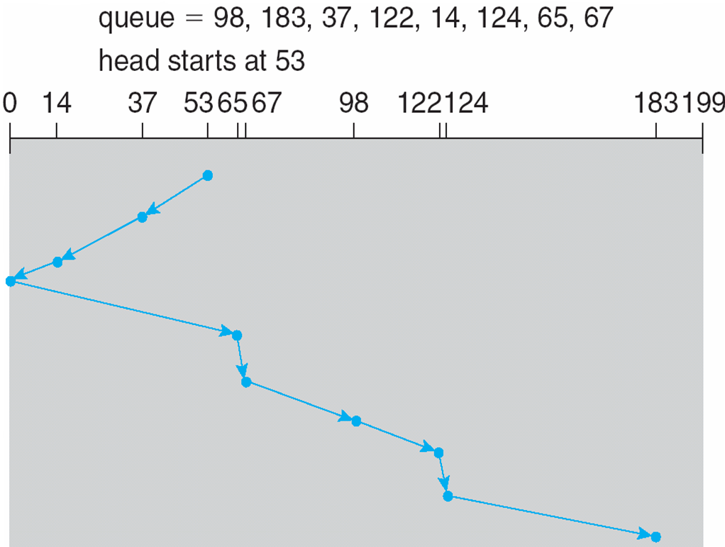
SCAN (Cont.)

Slide 14
C-SCAN
Provides a more uniform wait time than SCAN
The head moves from one end of the disk to the other, servicing requests as it goes
When it reaches the other end, however, it immediately returns to the beginning of the disk, without servicing any requests on the return trip
Treats the cylinders as a circular list that wraps around from the last cylinder to the first one
Total number of cylinders?

Slide 15
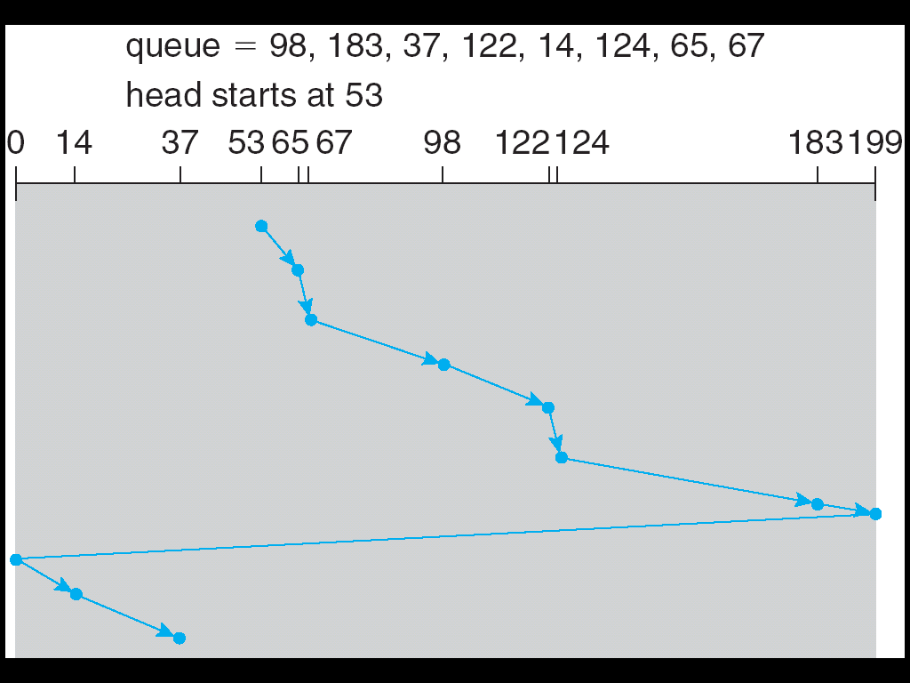
C-SCAN (Cont.)

Slide 16
C-LOOK
LOOK a version of SCAN, C-LOOK a version of C-SCAN
Arm only goes as far as the last request in each direction, then reverses direction immediately, without first going all the way to the end of the disk
Total number of cylinders?

Slide 17
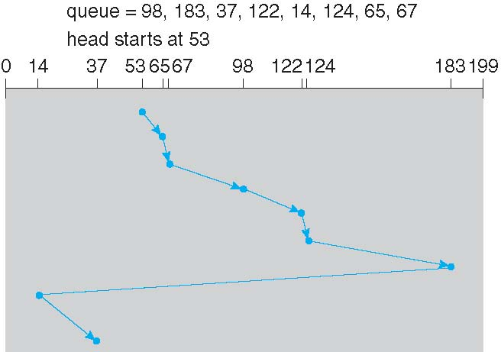
C-LOOK (Cont.)

Slide 18
Problem:
Suppose that a disk drive has 5000 cylinders, numbered 0 to 4999. The drive is currently serving a request at cylinder 143, and the previous request was at cylinder 125. The queue of pending requests, in FIFO
order, is:
86, 1470, 913, 1774, 948, 1509, 1022, 1750, 130
Starting from the current head position, what is the total distance (in cylinders) that the disk arm moves to satisfy all the pending requests for FCFS, SSTF, SCAN, LOOK, C-SCAN and C-LOOK.

Slide 19
Solution:
Work Queue is 86, 1470, 913, 1774, 948, 1509, 1022, 1750, 130
The FCFS schedule is 143, 86, 1470, 913, 1774, 948, 1509, 1022, 1750, 130. The total seek distance is 7081(7703).
The SSTF schedule is 143, 130, 86, 913, 948, 1022, 1470, 1509, 1750, 1774. The total seek distance is 1745.
The SCAN schedule is 143, 913, 948, 1022, 1470, 1509, 1750, 1774,4999, 130, 86. The total seek distance is 9769.
The C-SCAN schedule is 143, 913, 948, 1022, 1470, 1509, 1750, 1774, 4999, 0, 86, 130. The total seek distance is 9985.
The LOOK schedule is 143, 913, 948, 1022, 1470, 1509, 1750, 1774, 130, 86. The total seek distance is 3319.
The C-LOOK schedule is 143, 913, 948, 1022, 1470, 1509, 1750, 1774, 86, 130. The total seek distance is 3363.

